Slide 1
NAKUJA PROJECT- N2
AIRFRAME

Slide 2
Material One: Fiberglass
Properties: Durable, Offers high thermal insulation, mechanical strength.
Material/Equipment required for fabrication:
Form or mandrel (can be made from Aluminium or
wood)
Fibreglass fabric
Mold release
Epoxy (plus epoxy brush and mixing cup)
Latex gloves
Notes:
https://www.facebook.com/specialisedfibreglassltd/
Fiberglass – Types, Properties, and Applications | Phelps Industrial Products (phelpsgaskets.com)
Lightweight Fiberglass Tubes | National Association of Rocketry (nar.org)

Slide 3
Material One: Fiberglass
6. Cradle for the form or mandrel
7. Finishing materials (mylar **Aluminium foil)
8. A scale for mixing epoxy
9. Sand paper
10. Scissors
11. Acetone
Notes:
https://www.facebook.com/specialisedfibreglassltd/
Fiberglass – Types, Properties, and Applications | Phelps Industrial Products (phelpsgaskets.com)
Lightweight Fiberglass Tubes | National Association of Rocketry (nar.org)

Slide 4
Material One: Fiberglass
Price: 1. 130g 10m x 1m Fibreglass Fabric- Ksh. 2243- 367.
Notes:
https://www.facebook.com/specialisedfibreglassltd/
130g 10mx1m Fibreglass Fibre Glass Cloth Fabric Plain Weave For Model Airplane price from jumia in Kenya - Yaoota!
Fiberglass – Types, Properties, and Applications | Phelps Industrial Products (phelpsgaskets.com)
Lightweight Fiberglass Tubes | National Association of Rocketry (nar.org)

Slide 5
Material Two: Carbon Fiber
Properties: High Stiffness, high tensile strength, low
weight to strength ratio, high chemical resistance,
high temperature tolerance and low thermal expansion.
Materials required for Fabrication:
Form or mandrel
Mylar film (**Aluminium film)
Notes:
https://www.apogeerockets.com/education/downloads/Newsletter370.pdf

Slide 6
Material Two: Carbon Fiber
3.Peel ply (an extra layer of fabric material which is
laid upon the outer surface of carbon fiber during
fabrication).
4. Chip brushes
5. Epoxy resin
6. Scotch tape
Price: Carbon Fiber: 200mm x 300mm x 1.5mm- Ksh. 2139.
Peel Ply: Ksh.600-900 per square meter.
Notes:
https://www.apogeerockets.com/education/downloads/Newsletter370.pdf
Uv Resistance Fiberglass Peel Ply Fabric - Buy Peel Ply,Peel Ply,Peel Ply Product on Alibaba.com
Peel Ply 60 inch Wide – Fiberglass Source

Slide 7
Material Three: Balsa wood
Properties: Softest commercial hardwood. Light weight.
Price: 1. 75mm x 3.2mm x 305mm- Ksh. 5170.
2. 75mm x 3.2mm x 600mm- N/A.
Fabrication equipment: Drill bits, abrasive paper,
Wood glue, screws (if we’ll need to hold any two pieces
together.
Notes:
WWS Balsa Wood Sheets 75 x 305 x 3.2 mm (3 x 12 x 1/8 inch) - 9 Pack – Model Making Craft Aircraft Ship Modelling in Kenya | Whizz Trains & Accessories
Wood Fabrication Tutorial | UAS@UCLA (uasatucla.org)
200 x 300 x 1.5mm With 100% Real Carbon Fiber plate panel sheet 3K plain weave price from jumia in Kenya - Yaoota!

Slide 8
Material Three: Balsa wood
Properties: Softest commercial hardwood. Light weight.
Price: 1. 75mm x 3.2mm x 305mm- Ksh. 5170.
2. 75mm x 3.2mm x 600mm- N/A.
Fabrication equipment: Drill bits, abrasive paper,
Wood glue, screws (if we’ll need to hold any two pieces
together.
Notes:
WWS Balsa Wood Sheets 75 x 305 x 3.2 mm (3 x 12 x 1/8 inch) - 9 Pack – Model Making Craft Aircraft Ship Modelling in Kenya | Whizz Trains & Accessories
Wood Fabrication Tutorial | UAS@UCLA (uasatucla.org)
200 x 300 x 1.5mm With 100% Real Carbon Fiber plate panel sheet 3K plain weave price from jumia in Kenya - Yaoota!

Slide 9
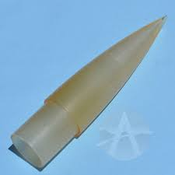
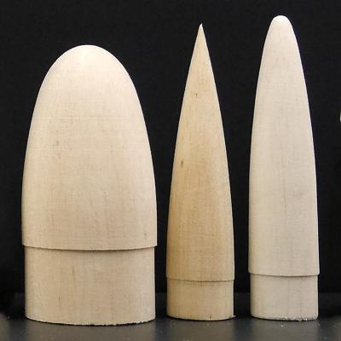
Nose cone
Can be made from Balsa wood or fibreglass.

Slide 10
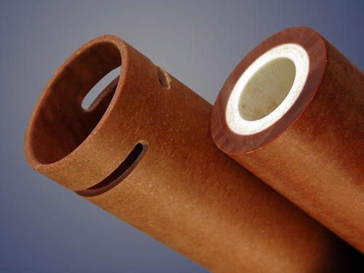
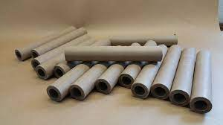
Body tube, payload (Airframe)
Can be made from phenolic tubing, carbon fiber, fibreglass, heavy-walled paper.
Notes:
Kevlar (para-aramid) is a heat-resistant and strong synthetic fiber.
These advanced materials handle the greater forces imposed by high-thrust motors and greater weights.
Our goal is to create a structure that will not fold under the stresses of flight.

Slide 11
Body tube, payload (Airframe)
Phenolic tubing is a resin impregnated, spiral wrapped
and heat curred tube. It is much stronger than a cardboard
Tubing, with almost 5x the compression strength. It is also
a very good base for rockets that will require the
strengthening of fibreglass, Kevlar, carbon fiber or
similar materials.
Notes:
Kevlar (para-aramid) is a heat-resistant and strong synthetic fiber.
Main disadvantages are low toughness and a curing reaction that involves the generation of water. This water can remain trapped within the composite and during a fire steam can generated which can damage the structure of the material.

Slide 12
Fins
Rigid materials are used to provide stiffness with minimum
thickness.
Balsa wood or basswood are used.
Wafer glass is also used- Thin material made from
plastics and fibreglass called G-10 (garolite).
High power rockets use aircraft-grade birch plywood or
thicker sheets of garolite.

Slide 13
Motor Tube and Centering rings
The motor tube is often made of the same material as
the airframe: phenolic tubing, carbon fiber, fibreglass, heavy-walled paper.
Centering rings are made from cardboard or balsa wood
(model-rocket) and plywood or garolite (high power
rockets).
Notes:
Garolie is a type of fibreglass.

Slide 14
References
https://wsuwp-uploads.s3.amazonaws.com/uploads/sites/44/2014/10/25.-Solid-Fuselage-Design-and-Structure.pdf
https://www.nar.org/landing/building-rockets-preview-of-member-guidebook/
https://www.nar.org/wp-content/uploads/2014/03/NAR-Rocketry-Basics.pdf
https://www.herts.ac.uk/rocketry/rocket-airframes
https://www.grc.nasa.gov/www/k-12/rocket/rockpart.html
https://howthingsfly.si.edu/ask-an-explainer/what-kind-materials-are-used-rockets
https://web.wpi.edu/Pubs/E-project/Available/E-project-040720-011451/unrestricted/Design,_Analysis,_and_Test_of_a_High-Powered_Model_Rocket.pdf
Notes:
https://www.herts.ac.uk/rocketry/rocket-airframes
https://www.grc.nasa.gov/www/k-12/rocket/rockpart.html
https://www.nar.org/landing/building-rockets-preview-of-member-guidebook/
https://www.nar.org/wp-content/uploads/2014/03/NAR-Rocketry-Basics.pdf
https://howthingsfly.si.edu/ask-an-explainer/what-kind-materials-are-used-rockets
https://web.wpi.edu/Pubs/E-project/Available/E-project-040720-011451/unrestricted/Design,_Analysis,_and_Test_of_a_High-Powered_Model_Rocket.pdf
https://www.asp-rocketry.com/ecommerce/Model-Rocket-Parts-Building-Materials.cfm?cat_id=7
https://askdruniverse.wsu.edu/2015/06/28/what-materials-would-you-use-to-make-a-rocket/
https://themodelrocket.com/best-materials-to-make-model-rockets/
http://www.unm.edu/~tbeach/IT145/week05/parts.html
https://themodelrocket.com/best-materials-to-make-model-rockets/

